Slide 1
Unit - 1
NNDL

Slide 2
What is a Neural Network?
A neural network is a massively parallel distributed processor made up of simple processing units, which has a natural propensity for storing experiential knowledge and making it available for use.
Knowledge is acquired by the network from its environment through a learning process. The procedure performing learning process is called a learning algorithm.

Slide 3
Conventional Computer | Human brain
To solve the problem computer uses sequential approach. It follows the set of instructions to solve the given problem. It restricts problem solving ability of computer. | To solve the problem large number of highly interconnected nodes work in parallel. It learns by example. Eg: Small child, experienced doctor.
Computer has centralised control for all the operations. | It is a distributed control system. Each neuron acts based on information locally available and transmits info of its output to neuron connected to it.
Computer stores the information in memory. | Human brain stores information in its connection weights.
Information stored in computer memory is replaceable. | Information stored in human brain is adaptable. Eg: Face recognition.
Computer has no tolerance. If information in memory is corrupt, it can not be retrieved. If one or other part goes the it stops working. Eg: SMPS, RAM, Hard disk. | In biological neural network the information is distributed in the connections through out the network. Even if one or other connection fails or one or other neuron stops working, information can still be retrieved. Still network performs well. Eg: Deaf and dumb person.

Slide 4
Biological Neural Network
Consider a single biological neuron…
neuron

Slide 5
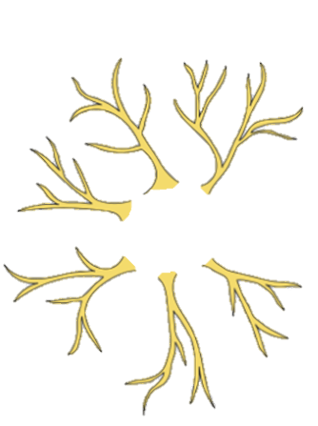
Biological Neural Network
A neuron requires input(s) to perform its task…
So, we have DENDRITES, which act as input paths to the neuron.
Dendrites

Slide 6
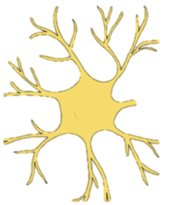
Biological Neural Network
The input needs to be collected and connected to the neuron.
So, all the DENDRITES, are connected to the CELL BODY of the neuron,
which collects all the inputs for further processing.
The cell body of the neuron is also called SOMA
Cell Body
SOMA

Slide 7
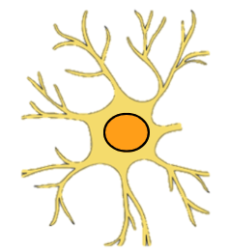
Biological Neural Network
The input collected needs to be processed by the neuron.
The NUCLEUS of the cell is in charge of the
input processing and generating output.
The nucleus acts as a reservoir of biological instructions.
Controls the neuron activities.
Nucleus

Slide 8
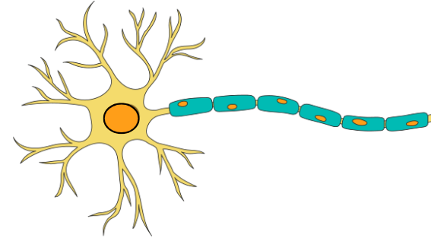
Biological Neural Network
After generating output at the nucleus, the output information needs to be transmitted
to corresponding neurons attached to the current neuron.
It is AXON’s responsibility to carry the output out from the cell’s nucleus.
Axon

Slide 9
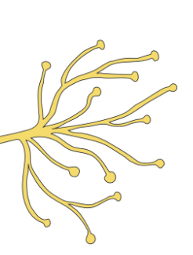
Biological Neural Network
Output carried by the Axon has to be transmitted to other co-ordinating neurons
AXON Terminals are the elements that are responsible for connection
and transmission of information to other neurons.
Axon Terminals

Slide 10
Biological Neural Network
Connecting Area of neurons
The places where neurons connect and communicate with each other are called SYNAPSES.
“Intended message” or “Action potential” is transmitted from the axon terminal of one neuron to the dendrites of another neuron.
Synapse

Slide 11
Biological Neural Network
Connecting Area of neurons
Question:
With multiple synapses trying to connect to the dendrites… which synapses should be allowed to connect?
Answer:
The STRONGEST Synapse will be allowed to connect to the dendrites.
Synapse

Slide 12
Biological Neural Network
Connecting Area of neurons
Question:
What makes a Synapse stronger?
Answer:
Rapidly and repeatedly activating the synapses makes them stronger.
Synapse

Slide 13
Biological Neural Network
Node of Ranvier, - a periodic gap in the insulating Myelin sheath
on the axon of a neurons
Myelin Sheath
Myelin Sheath - It allows the electrical impulses to travel quickly and efficiently between one nerve cell and the next.
Due to the Node of Ranvier – the action potential signal leaps from node to node across the axon instead of smoothly passing through the axon.
Node of Ranvier

Slide 14
02 types of Neurons:
  a. Sensory Neurons.
  b. Motor Neurons.
Important functions of a neuron:
  A. Chemical Synapse
    Neurotransmitters transfer nerve signal through chemical synapse
  B. Electrical Synapse
    When 2 neurons are connected by “gap junction”, it results in an electrical synapse. These gaps include ions.

Slide 15
Why is brain a “massively parallel feedback” dynamical system?
Non-linear
Non-local
Non-stationary

